Slide 1
Career guidance system
GROUP 1
YASVINIPPRIYAA S K – 2021506126
TEJASREE M S – 2021506113
RUDHRA Y – 2021506076

Slide 2
CONTENTS
Problem statement
Objectives
About our project
ER diagram
Snapshots of the project and the database

Slide 3
PROBLEM STATEMENT
To make students explore their area of interest and choose the career of their choice and what they love to do which will help them flourish monetarily and help them in a longer run.

Slide 4
OBJECTIVES
To enable a login platform for the user
To let the user take the career guidance test once and to store that result so that the user can view it in the future
To navigate the flow of subsequent questions based on the answer provided by user to previous questions
To create a warm ambience that promotes career exploration and decision making
Empowering young kinds with the apt guidance.

Slide 5
ABOUT OUR PROJECT

Slide 6
A career management system is a tool or platform that helps individuals choose their career. Our project career management system offers guidance on career planning and goal setting. It can be useful for people at all stages of their careers, from those just starting out to those looking to advance or make a career change however it mainly focuses on students coming out of school.
Deciding on a career is an important process because it can have a significant impact on future. A career is not just a job or a source of income, but rather it is a long-term pursuit that will likely occupy a significant portion of your life and play a major role in shaping identity and sense of purpose. It's important to choose a career that aligns with your values, interests, and skills, and that provides fulfillment and satisfaction.

Slide 7
Choosing a career is also an important decision because it can be difficult to change careers once you have invested time and resources into a particular field. It's important to take the time to research and consider your options before making a decision, and to be open to seeking advice and guidance from others who may have more experience or knowledge in this area.
Our system facilitates people to log in and take up a career guidance test so end of the test they will be able to explore their area of interest.

Slide 8
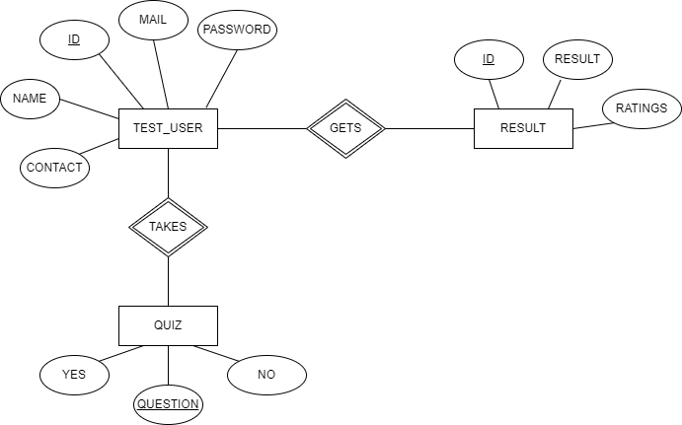
Er diagram

Slide 9
Demo of the process

Slide 10
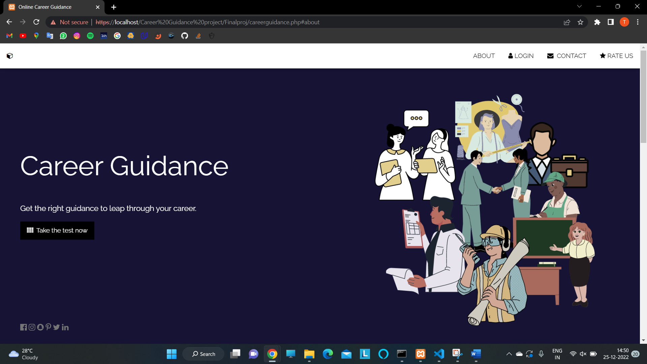
.

Slide 11
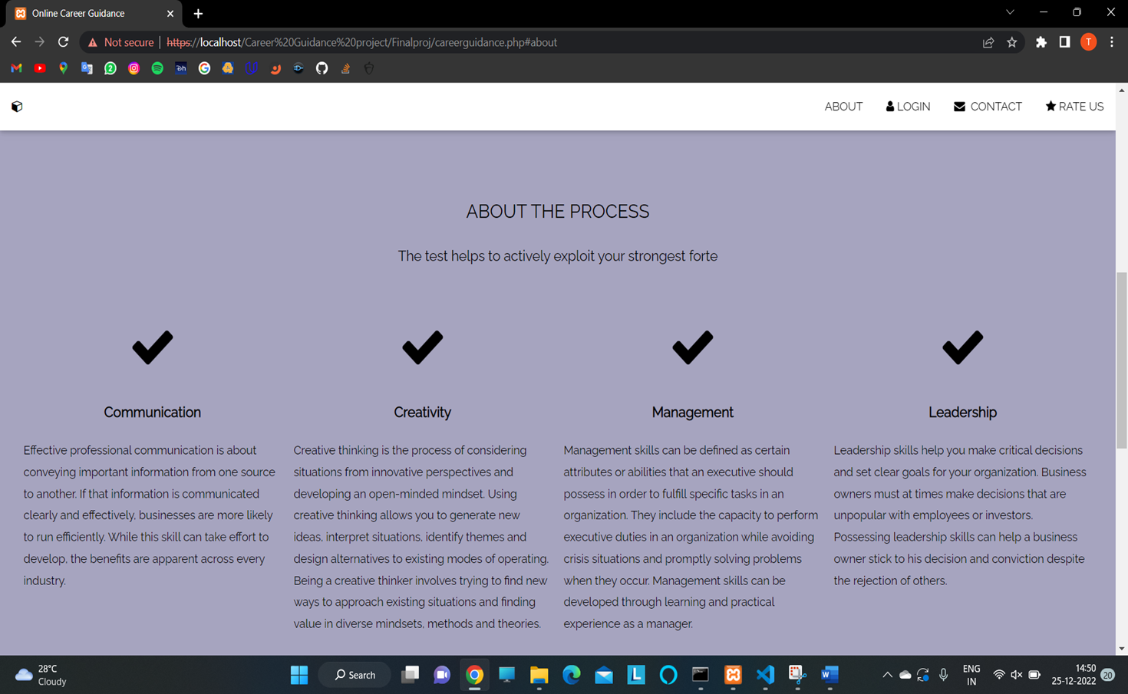
.

Slide 12
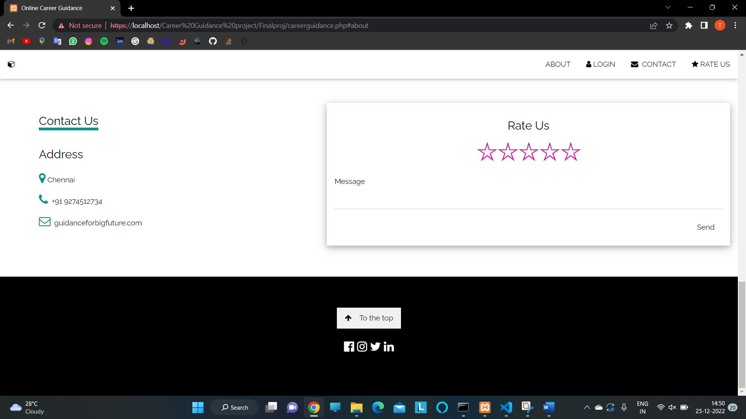
.

Slide 13
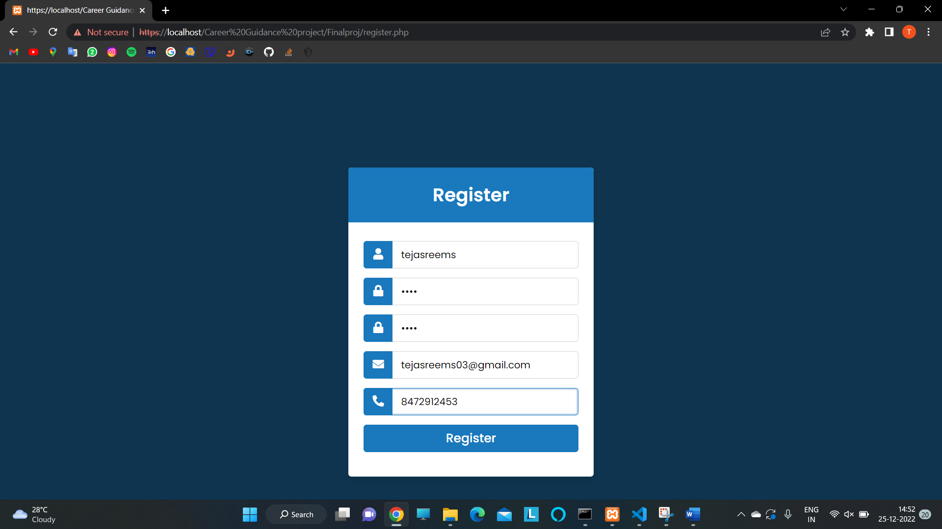
.

Slide 14

.

Slide 15
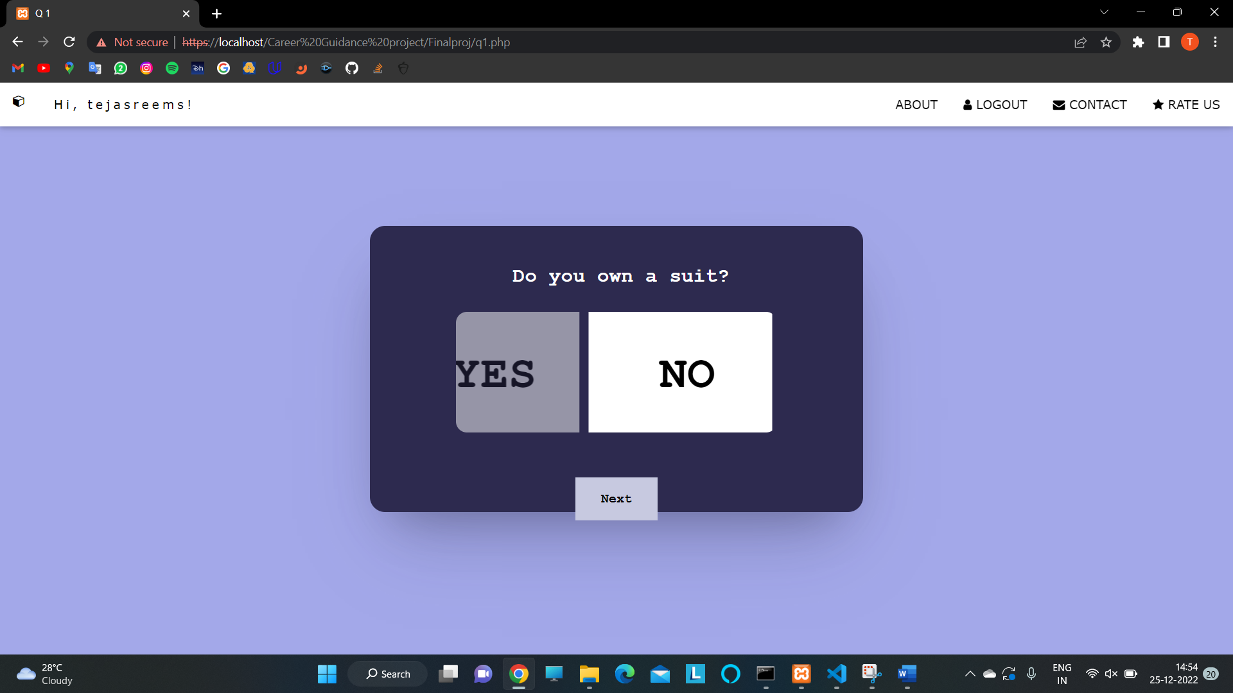
.

Slide 16
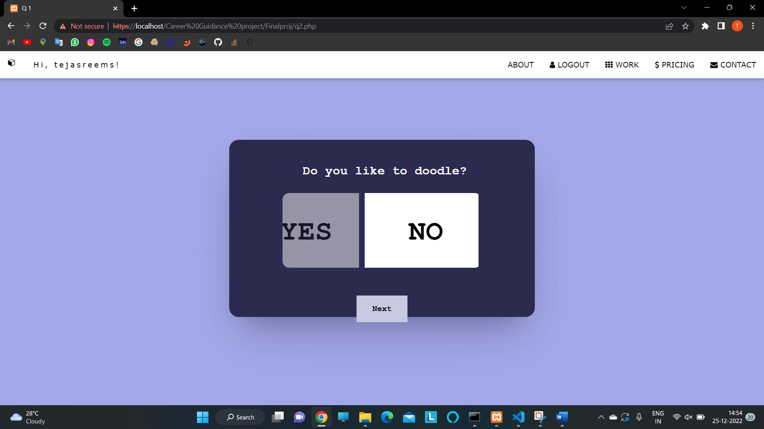
.

Slide 17
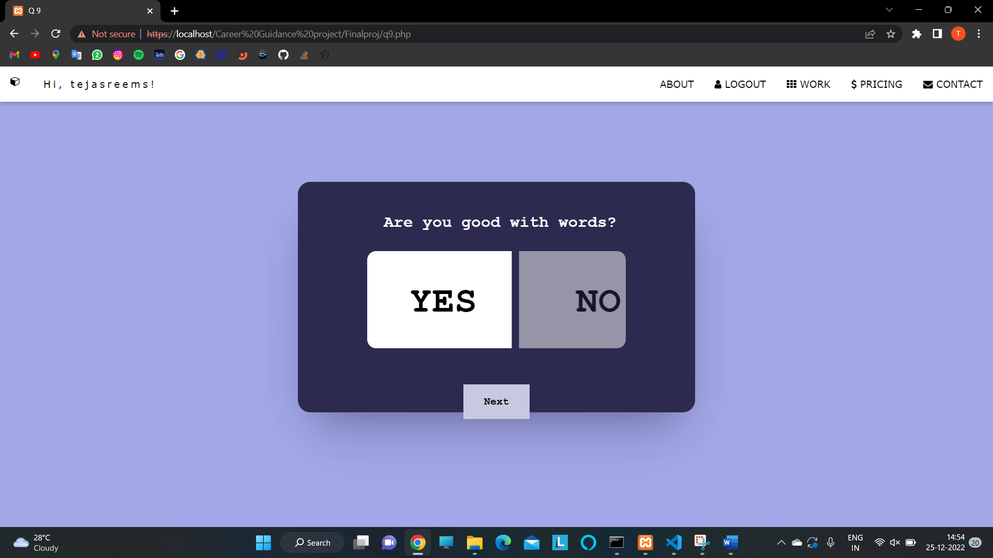
.

Slide 18

.

Slide 19

.

Slide 20
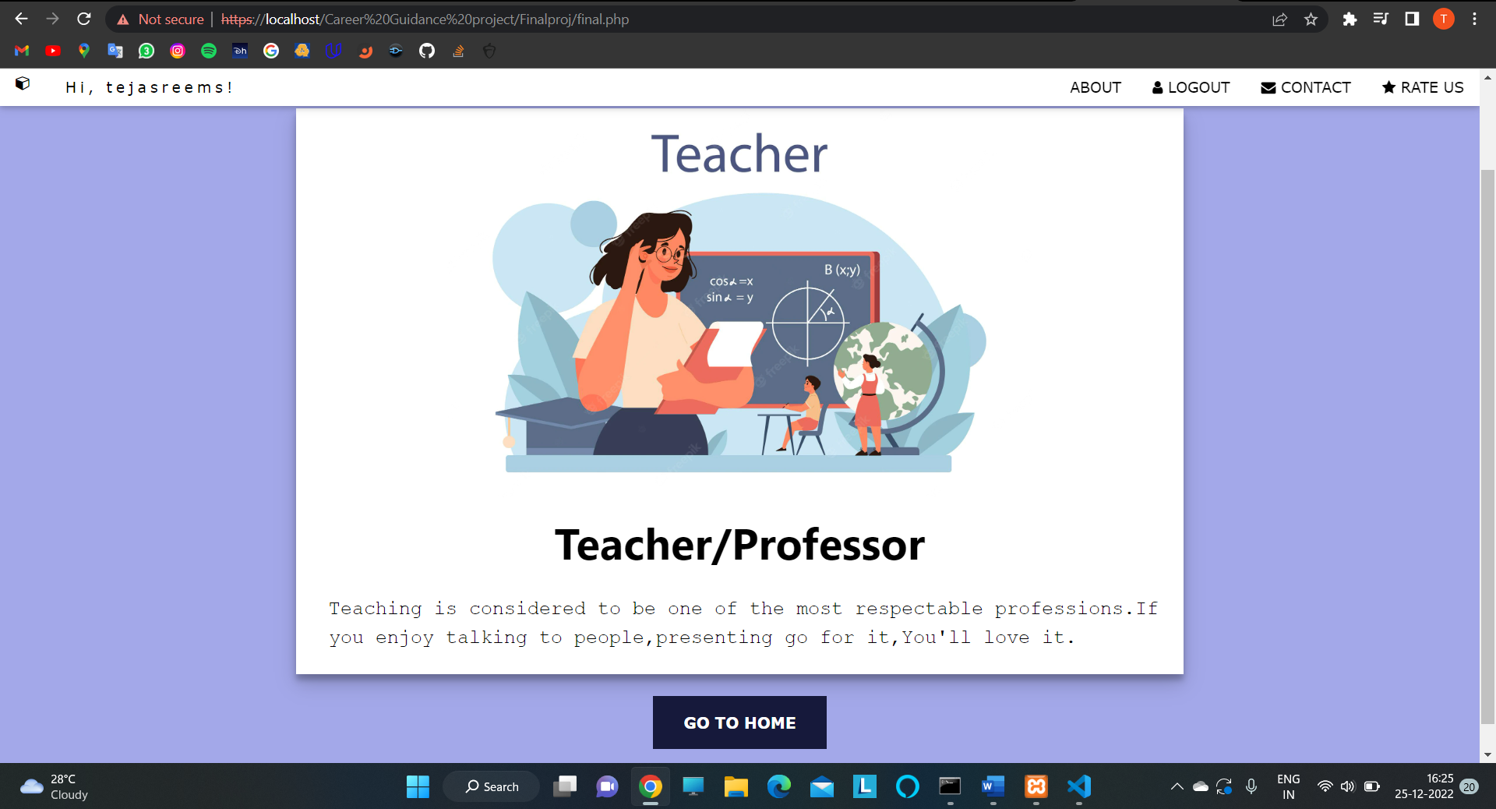
.

Slide 21
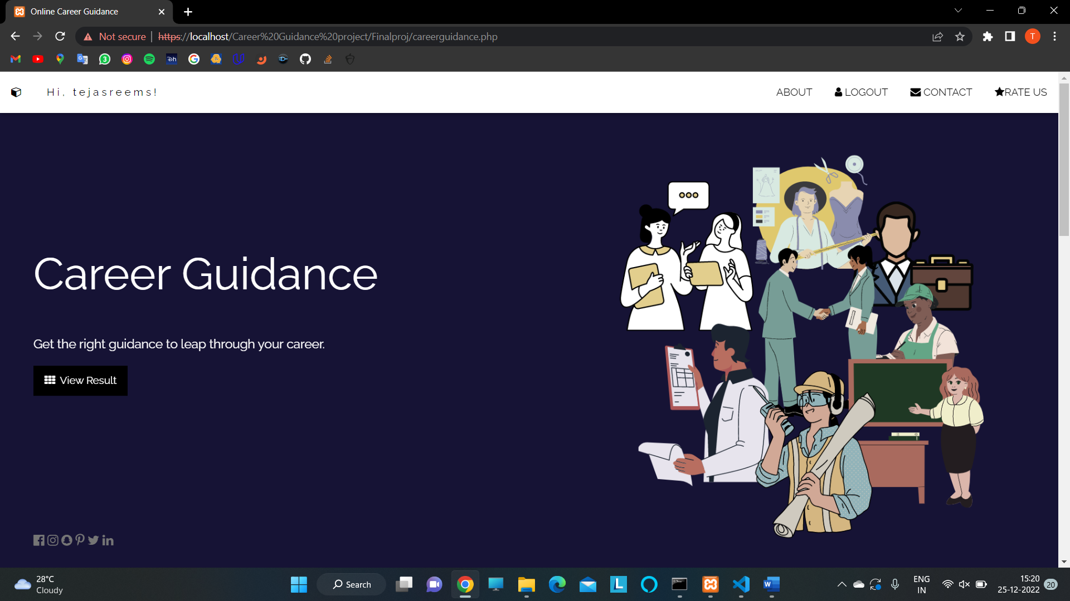
.

Slide 22
Possible career suggestion (based on user’s answering)

Slide 23
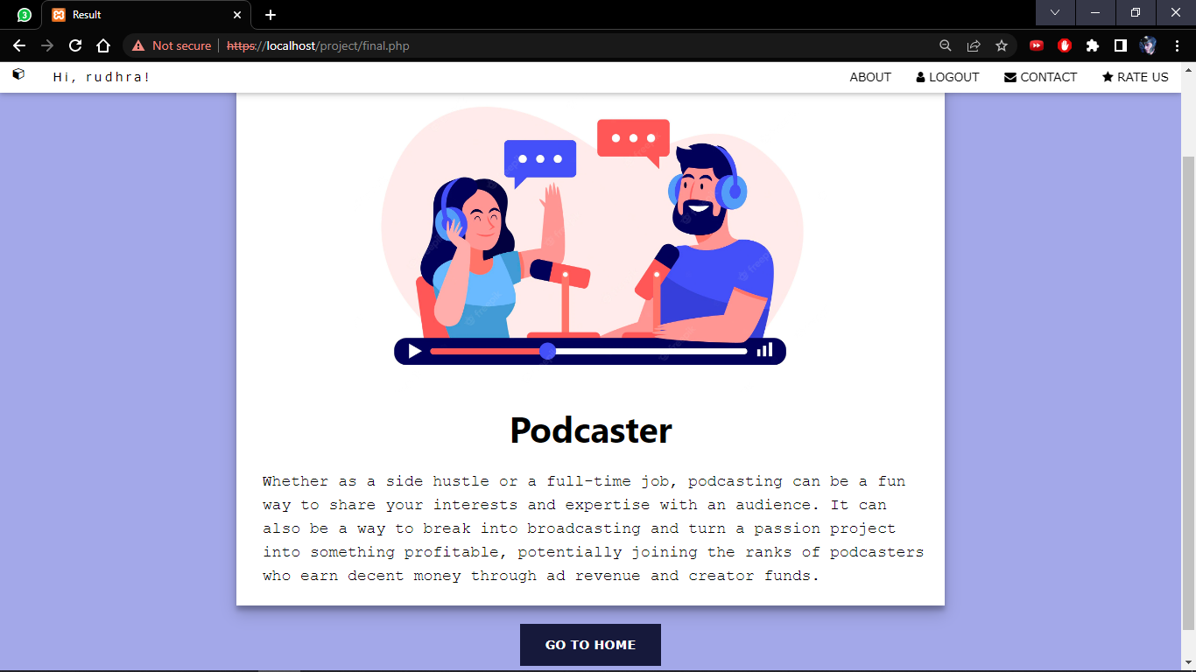
.

Slide 24
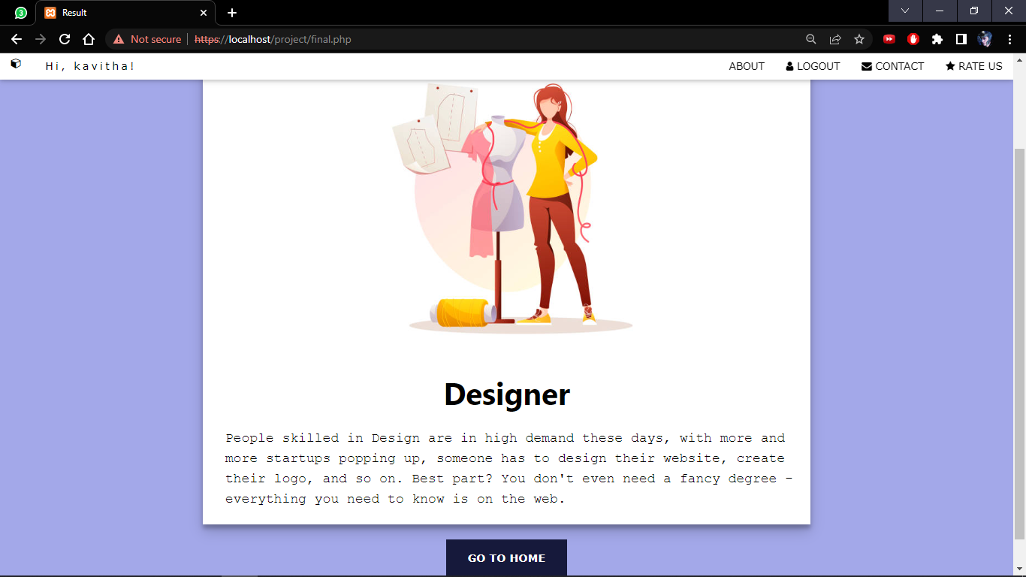
.

Slide 25
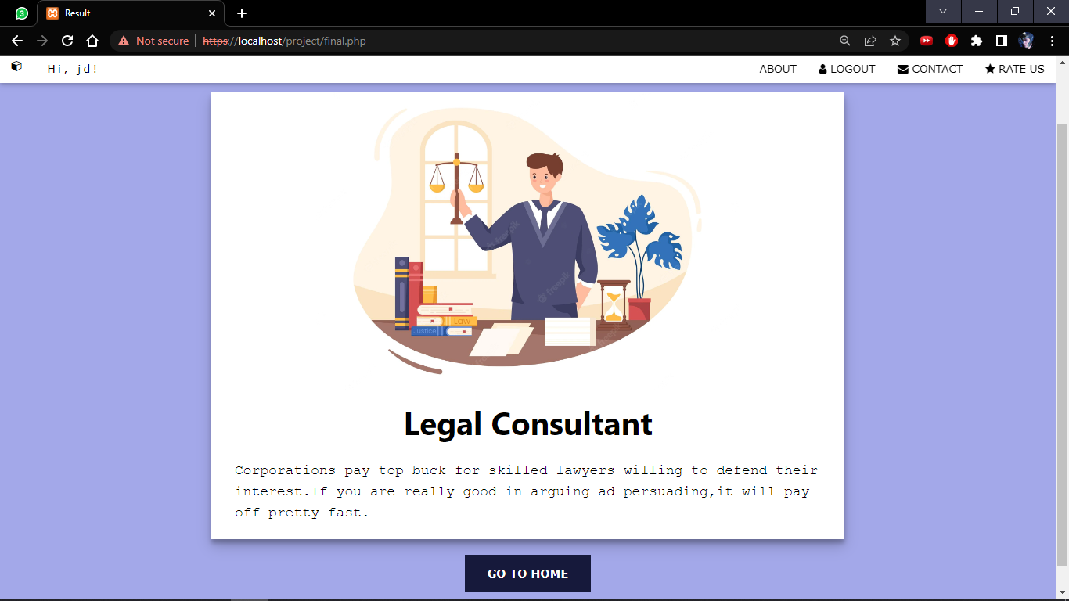
.

Slide 26
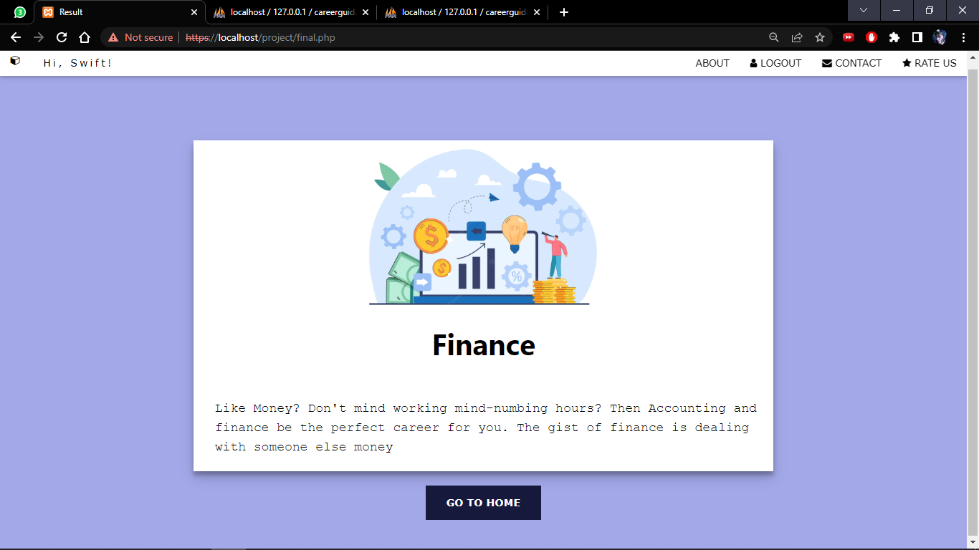
.

Slide 27
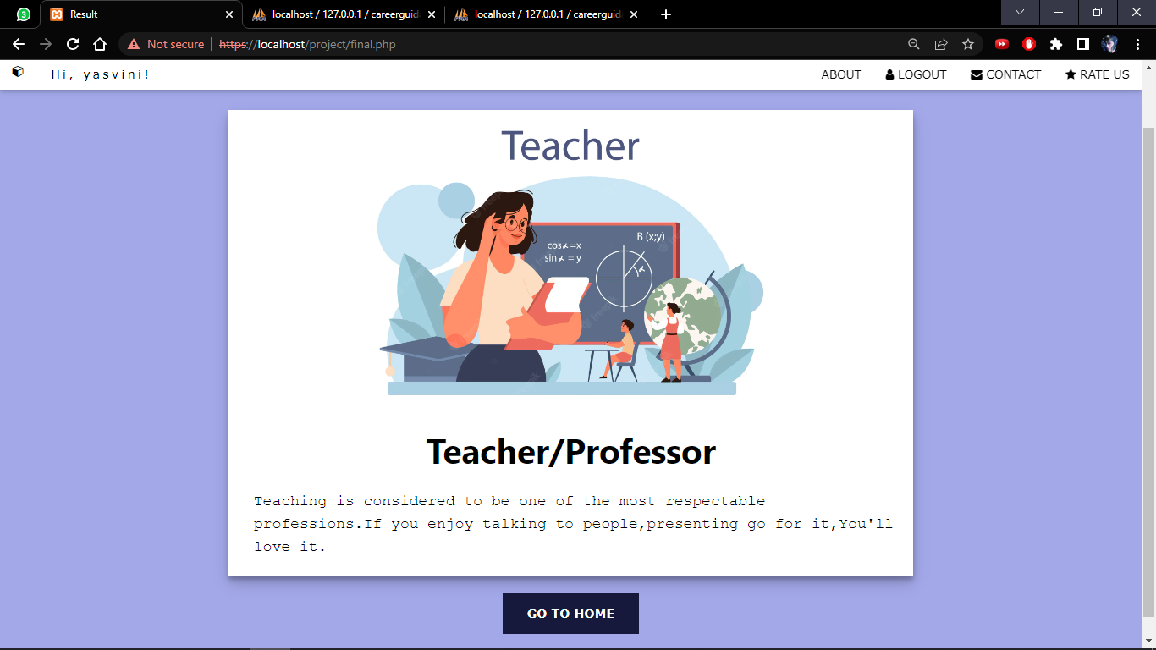
.

Slide 28
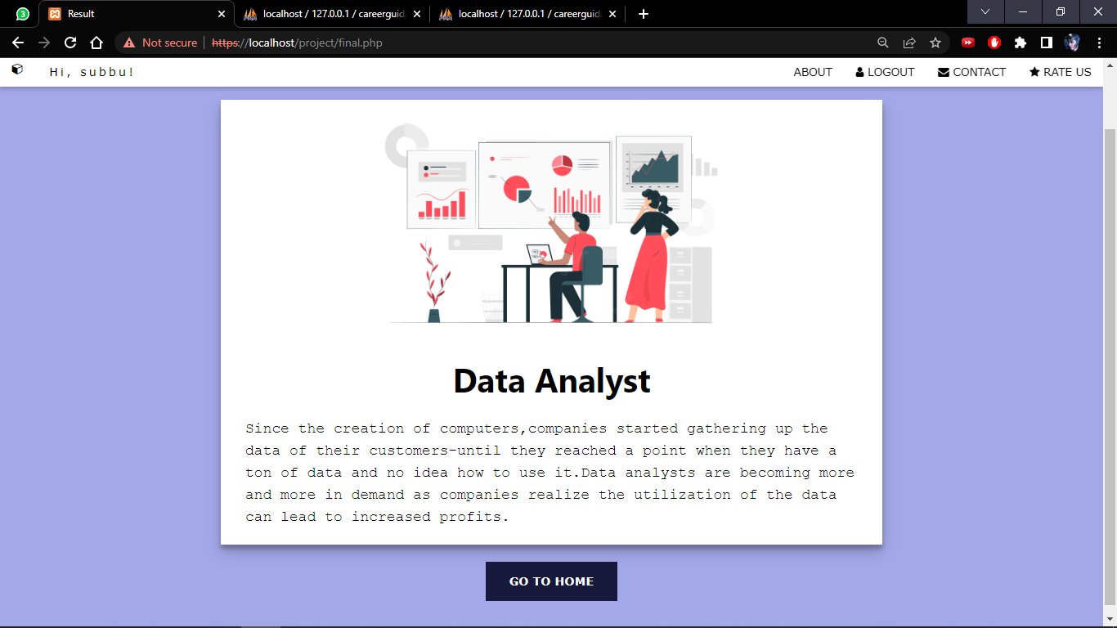
.

Slide 29
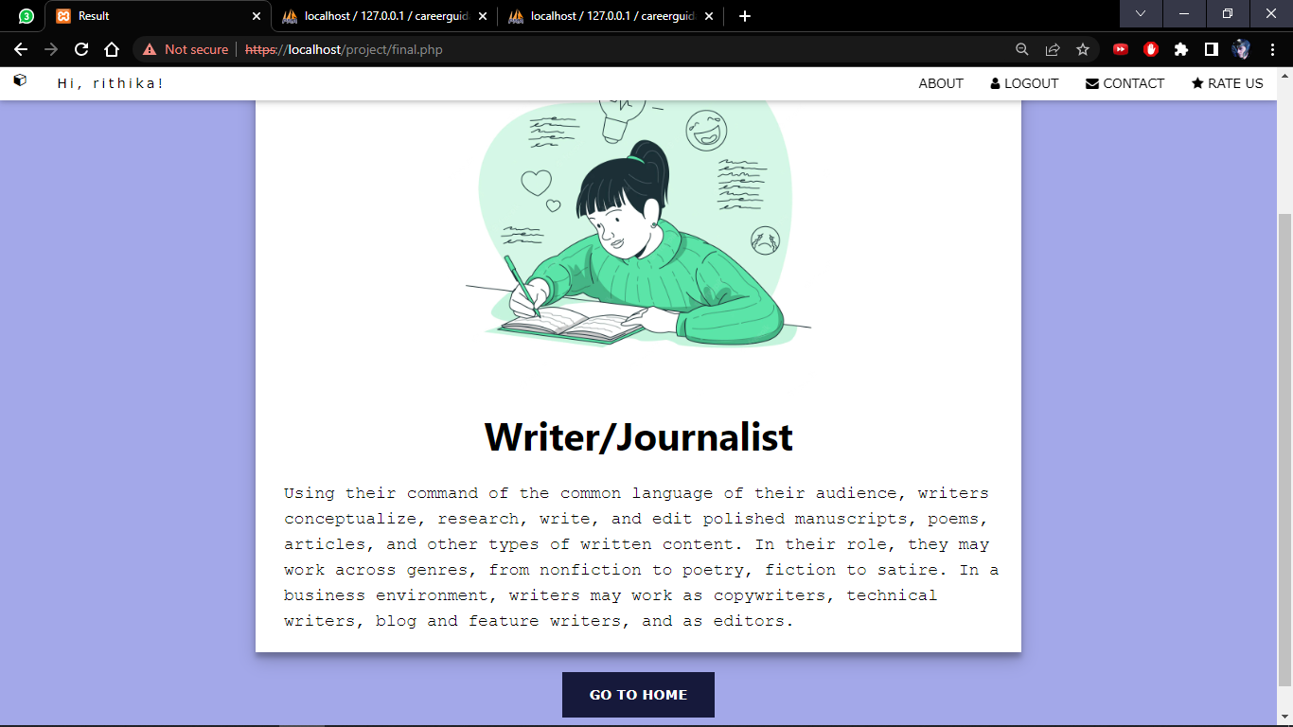
.

Slide 30
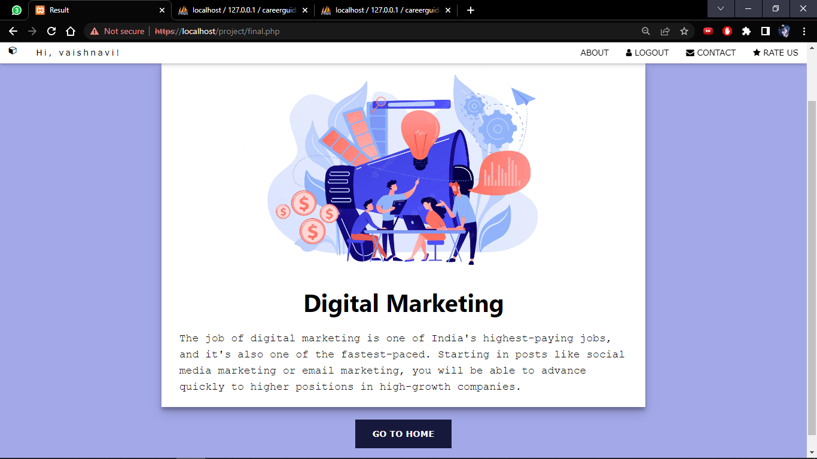
.

Slide 31
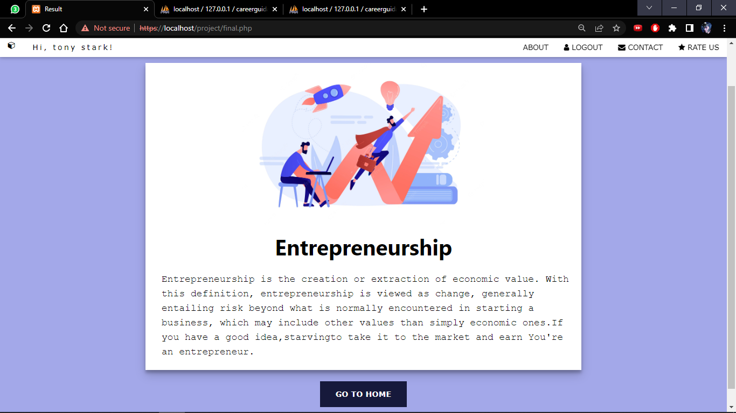
.

Slide 32
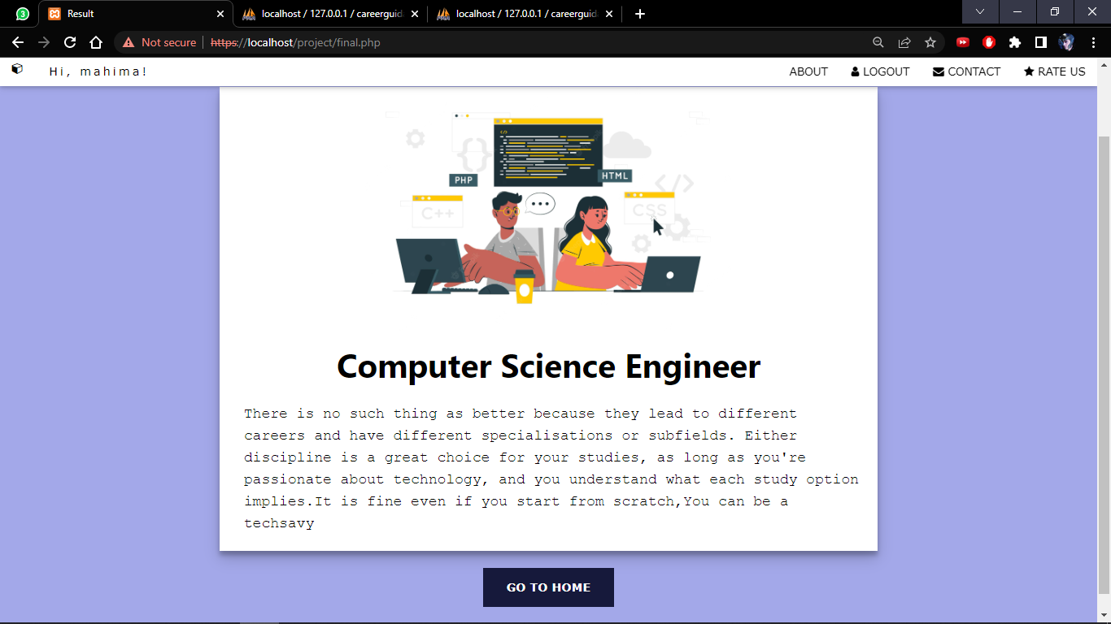
.

Slide 33
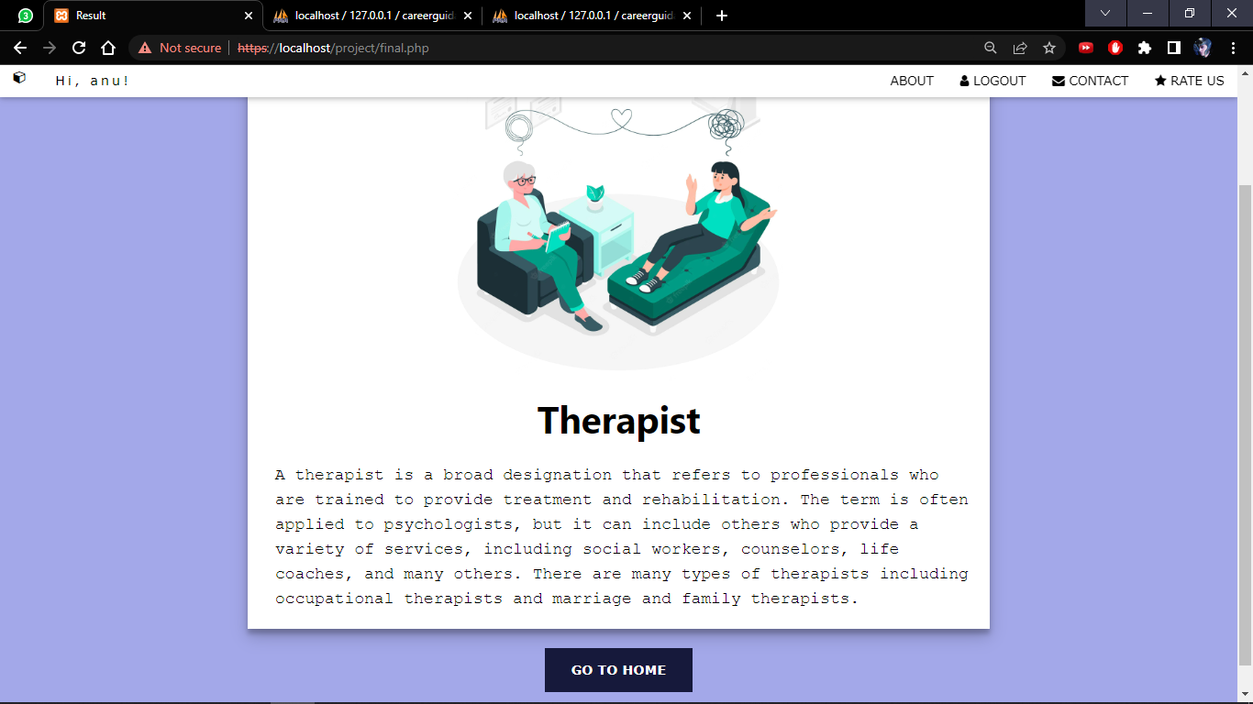
.

Slide 34
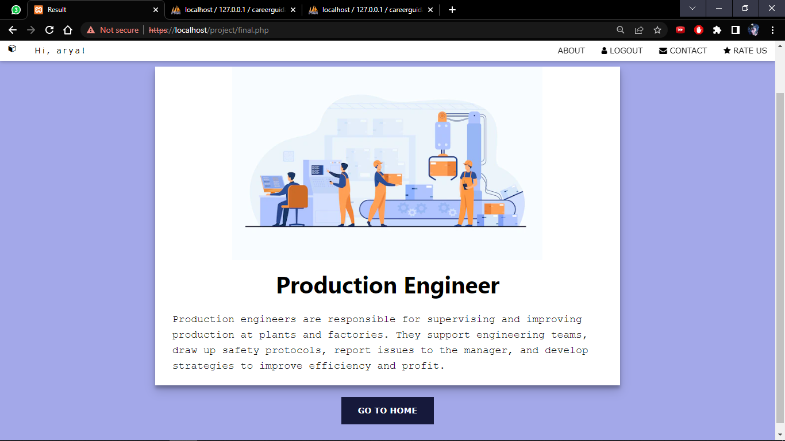
.

Slide 35
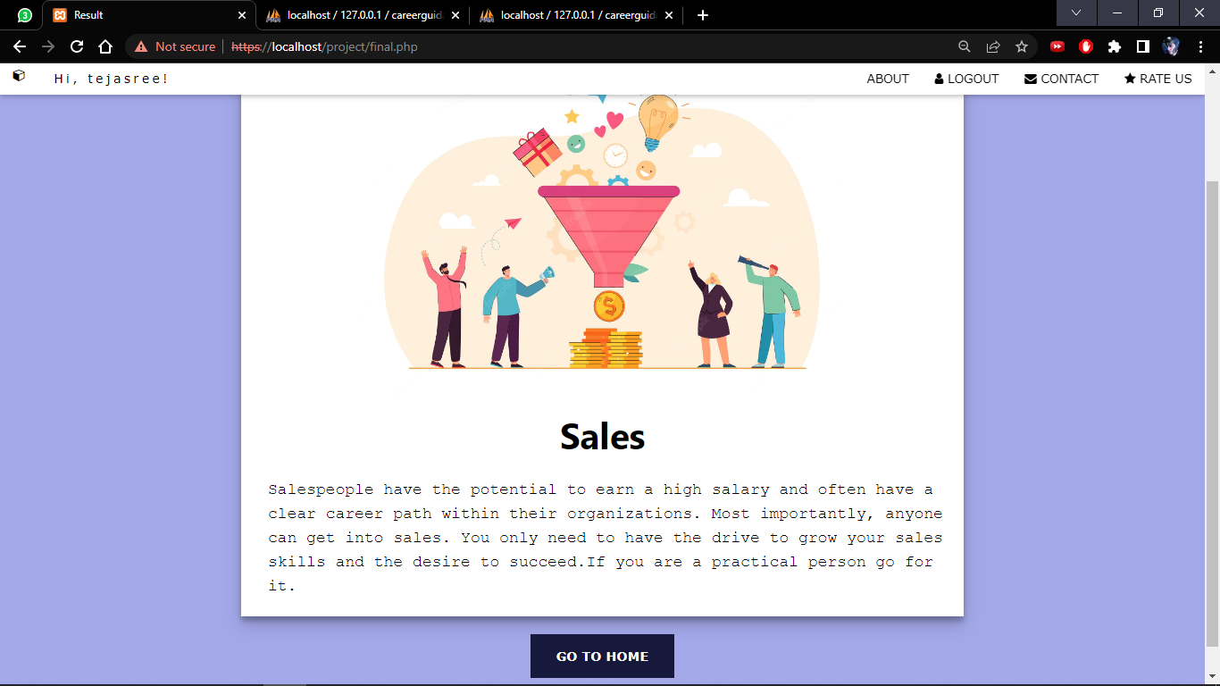
.

Slide 36
Database tables

Slide 37
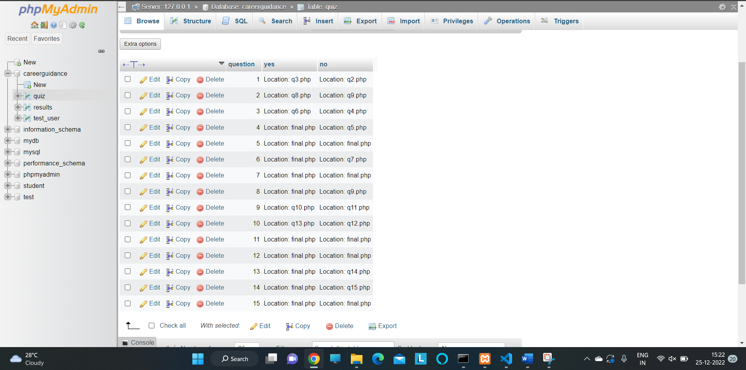
.

Slide 38
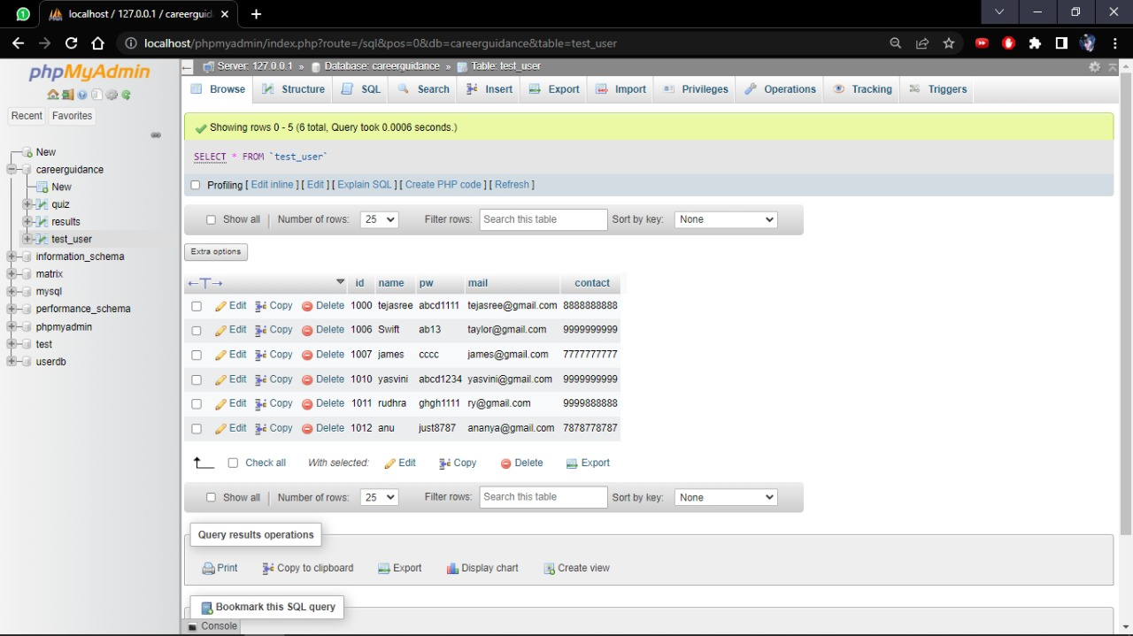
.

Slide 39
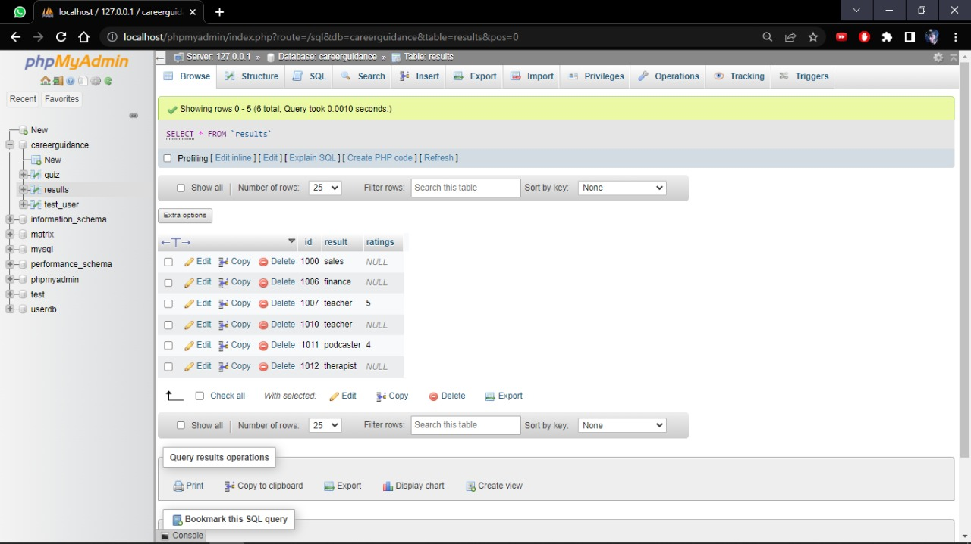
.

Slide 40
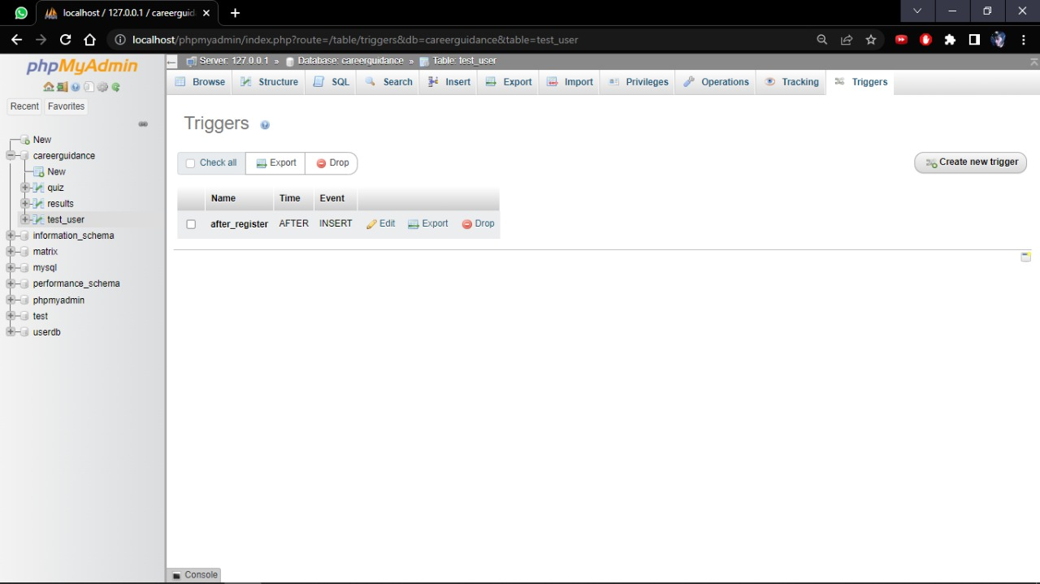
.

Slide 41
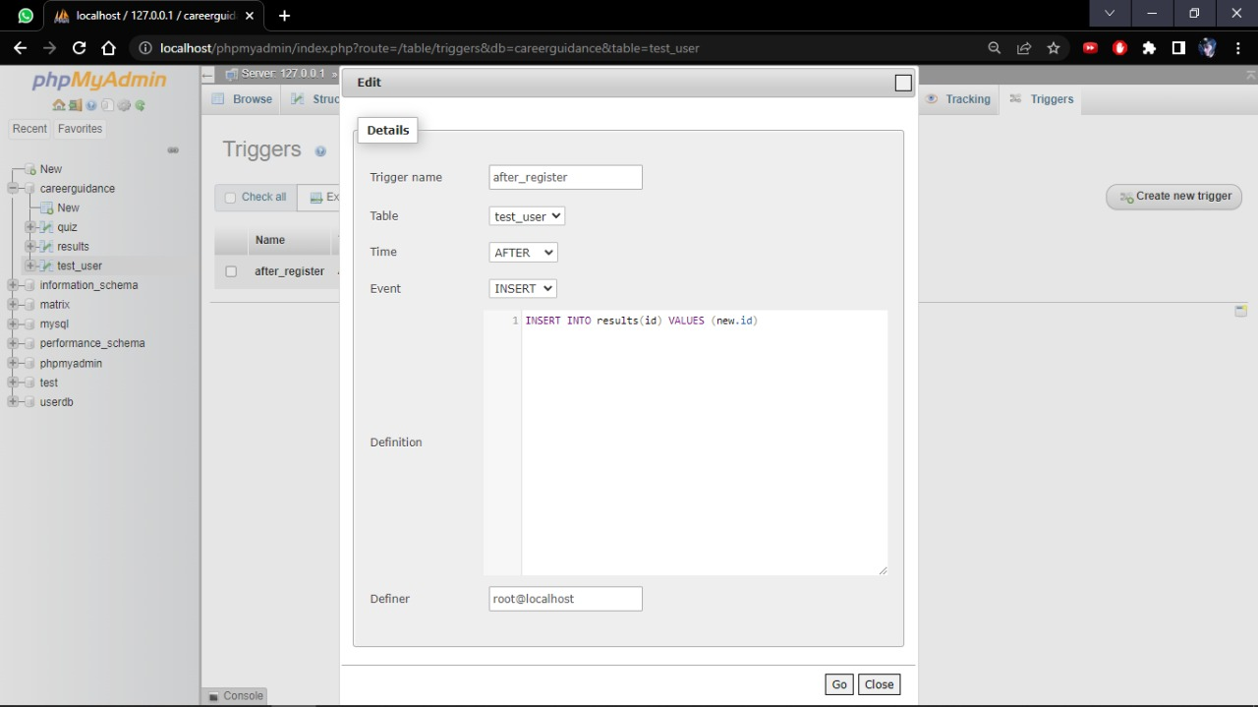
.

Slide 42
CONCLUSION
Thus the system we proposed provides perfect career guidance for the freshers by making them know what they love and what is going to excite them in future when they took it up as their career.

Slide 43
THANK YOU
YASVINIPPRIYAA S K – 2021506126
TEJASREE M S – 2021506113
RUDHRA Y – 2021506076

